Slide 1
AWS
Optimizing Cloud Infrastructure Cost and Performance with Starburst on AWS
Notes:
https://cloud.google.com/free/docs/free-cloud-features?_gl=1*9a96ko*_up*MQ..&gclid=CjwKCAjwk7DFBhBAEiwAeYbJsbjwEmiJjTLGpxmTcgdV7pE2QpNNzK-YvEynm-561tU2k0Uw4v59sRoCPqQQAvD_BwE&gclsrc=aw.ds&hl=id#storage
https://medium.com/@jushijun/deploying-a-machine-learning-model-with-docker-and-kubernetes-on-google-cloud-platform-21280db82840

Slide 2
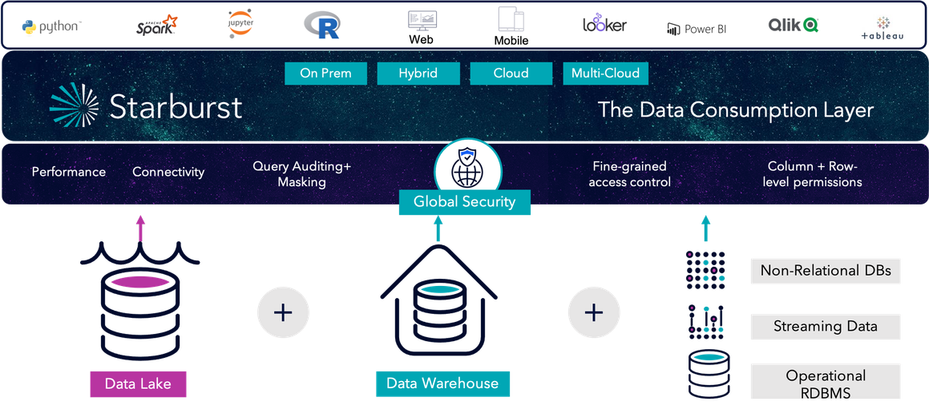

Slide 3
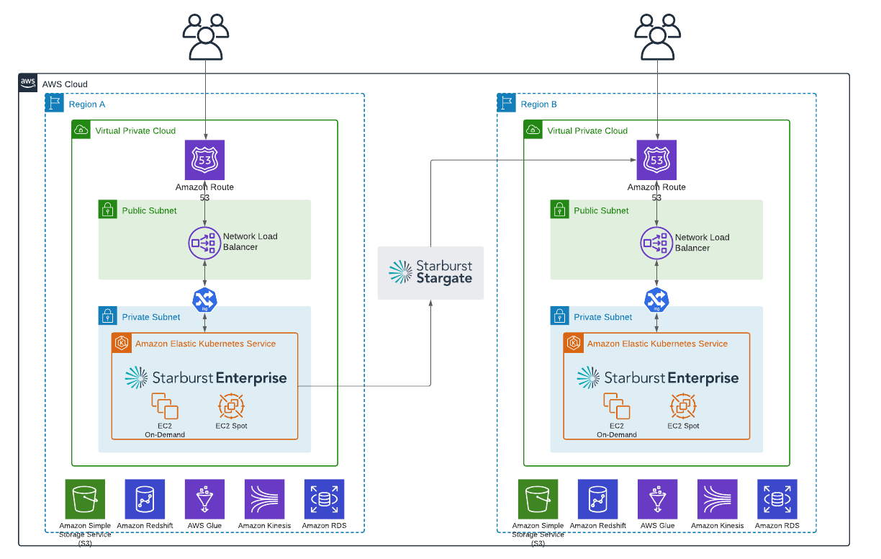
The platform can be deployed via AWS CloudFormation or Amazon Elastic Kubernetes Service (Amazon EKS). Starburst on AWS allows you to run analytic queries across AWS data sources and on-premises systems such as Teradata and Oracle.

Slide 4
Web Resources
Icon and sample diagrams landing page Optimizing Cloud Infrastructure Cost and Performance with Starburst on AWS
https://aws.amazon.com/id/blogs/architecture/optimizing-cloud-infrastructure-cost-and-performance-with-starburst-on-aws/

